Slide 1

Zomato review analysis using artificial intelligence (natural language processing algorithm)
SmartBridge-Remote Summer Internship Program
DevelopedBy:
Kavya.Dastari
Vyshnavi.Thanugula
Manasa.Chennaboina
Kaki.VishalReddy

Slide 2
Synopsis
1.Introduction
2.Sentiment analysis
3.Flowchart
4.Advantages
5.Disadvantages
6.conclusion

Slide 3
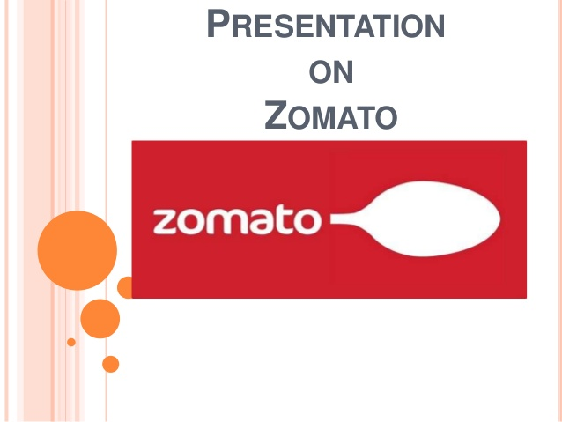
introduction
Zomato is an online discovery guide for restaurants, bars, pubs and clubs and for dine-outs.
Zomato has proven to be a phenomenal foodie platform, providing a convenient way to review restaurants,feedbacks, listings in (now)over 24 different countries.
The platform is even capable of giving insightful analytics for the restaurant to help route their business to exponential growth.
The platform is ideal for both food lovers and restaurant owners.Users can also view pictures and menus for restaurants that do not have a website of their own.
The Zomato platform is designed with smart search engine filters,meaning that it will search for only relevant restaurants as per to the searched relevant keyword.
Zomato acts as the key-bridge to providing relevant information on potential restaurants for users that searches with keywords or keyphrases relevant to the restaurant.

Slide 4
Sentiment analysis
Sentiment analysis is the field of study that analyzes people's opinions, sentiments, evaluations, attitudes, and emotions from written language. It is one of the most active research areas in natural language processing and is also widely studied in data mining, Web mining, and text mining.

Slide 5
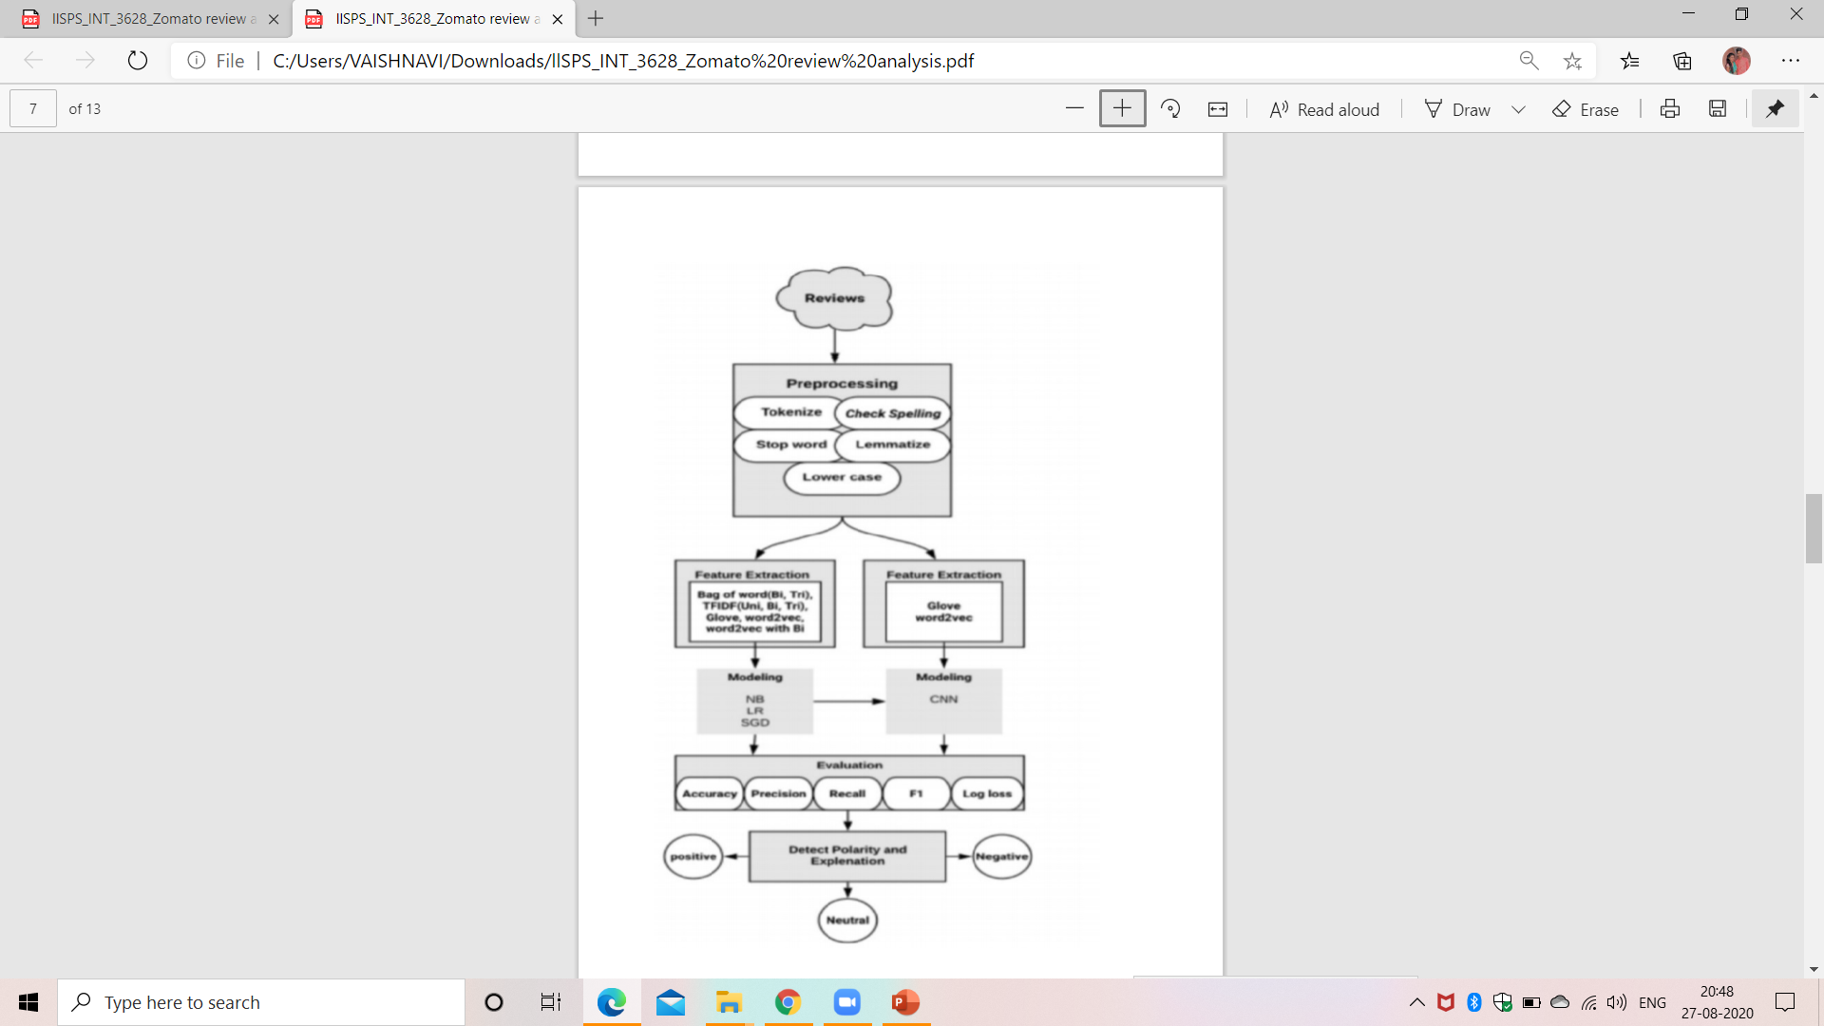
FLOWCHART

Slide 6
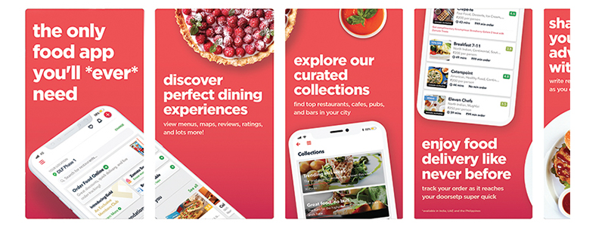
advantages
Google maps tried to compete with Zomato by showing nearby restaurants on their maps withlocations,user reviews,and ratings,but Zomato had a clear edge over Google maps being better in quality.being user-friendly and having TOMA(Top of Mind Awareness).
Zomato serves as an advertising platform for local restaurants specific to the area the user is accessing it from.
As Zomato offers advertising options for restaurants.it takes away a part of advertising business of Google (in context of restaurant ads).
Increase sales and revenue.
Daily and Monthly revenue reports.

Slide 7
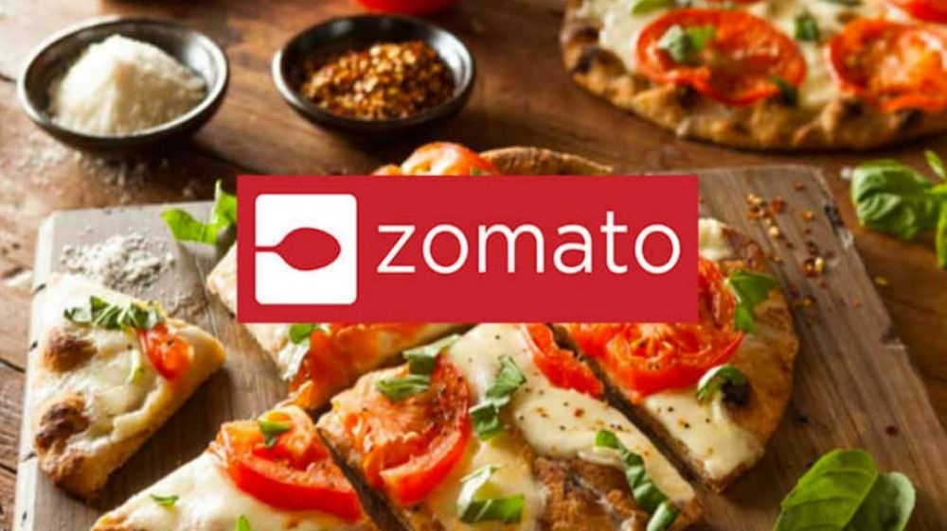
disadvantages
Data security
Risk of losing customer's data
Chance of a technical problem in the system
Mismatch data of orders,customers and drivers.
Difficulty in choosing the right developer to develop a customized system.

Slide 8
CONCLUSION:
1.Zomato’s item review platform shows that most of the reviewers have given 4-star and 3-star ratings to various dishes,items,sweets etc.... 2.average length of the reviews comes close to 230 characters. We also uncovered that lengthier reviews tend to be more helpful and there is a positive correlation between price & rating. 3.Sentiment analysis shows that positive sentiment is prevalent among the reviews and in terms of emotions, ‘trust’, ‘anticipation’ and ‘joy’ have highest scores. It’d be interesting to perform further analysis based on the platform(example:Swiggy etc.). 4.We can also look at building a model to predict the helpfulness of the review and the rating based on the review text.
5.Corpus-based and knowledge-based methods can be used to determine the semantic similarity of Review text. There are many more insights to be unveiled from the Zomato review

Slide 9

thankyou
THANKYOU

